Slide 1
ML Project: House Price Prediction
Sanika Mhadgut (20020214)
Krutin Rathod (20022825)

Slide 2
Dataset Overview
Dataset Overview:
Regression Type: House Price Prediction
Target Variable: 'Sale Price' (Numerical Value)
Initial Rows: 1022
Initial Features: 82
Target Column Included
Objective: Reduce to 35 Features
By Performing:-
Feature Engineering
Feature Selection
Dimensionality Reduction
Rows: 1022
Columns: 82 (including target column)

Slide 3
Feature Correlation Analysis and Selection
Correlation Matrix Analysis:
Utilized a correlation matrix to evaluate relationships among features.
Columns with > 80% correlation:
'1stFlrSF', 'GarageArea','GarageYrBlt',’Id', 'TotRmsAbvGrd'
Removed Features:
'GarageYrBlt' (time series data, redundant with house construction year)
'Id' (randomly generated numeric value)
Importance for Feature Retention:
1stFlrSF: Importance in setting house price, reflecting the area of the house.
GarageArea: Indicates the area for car accommodation, a relevant factor.
TotRmsAbvGrd: Number of rooms above grade, influencing house value.

Slide 4
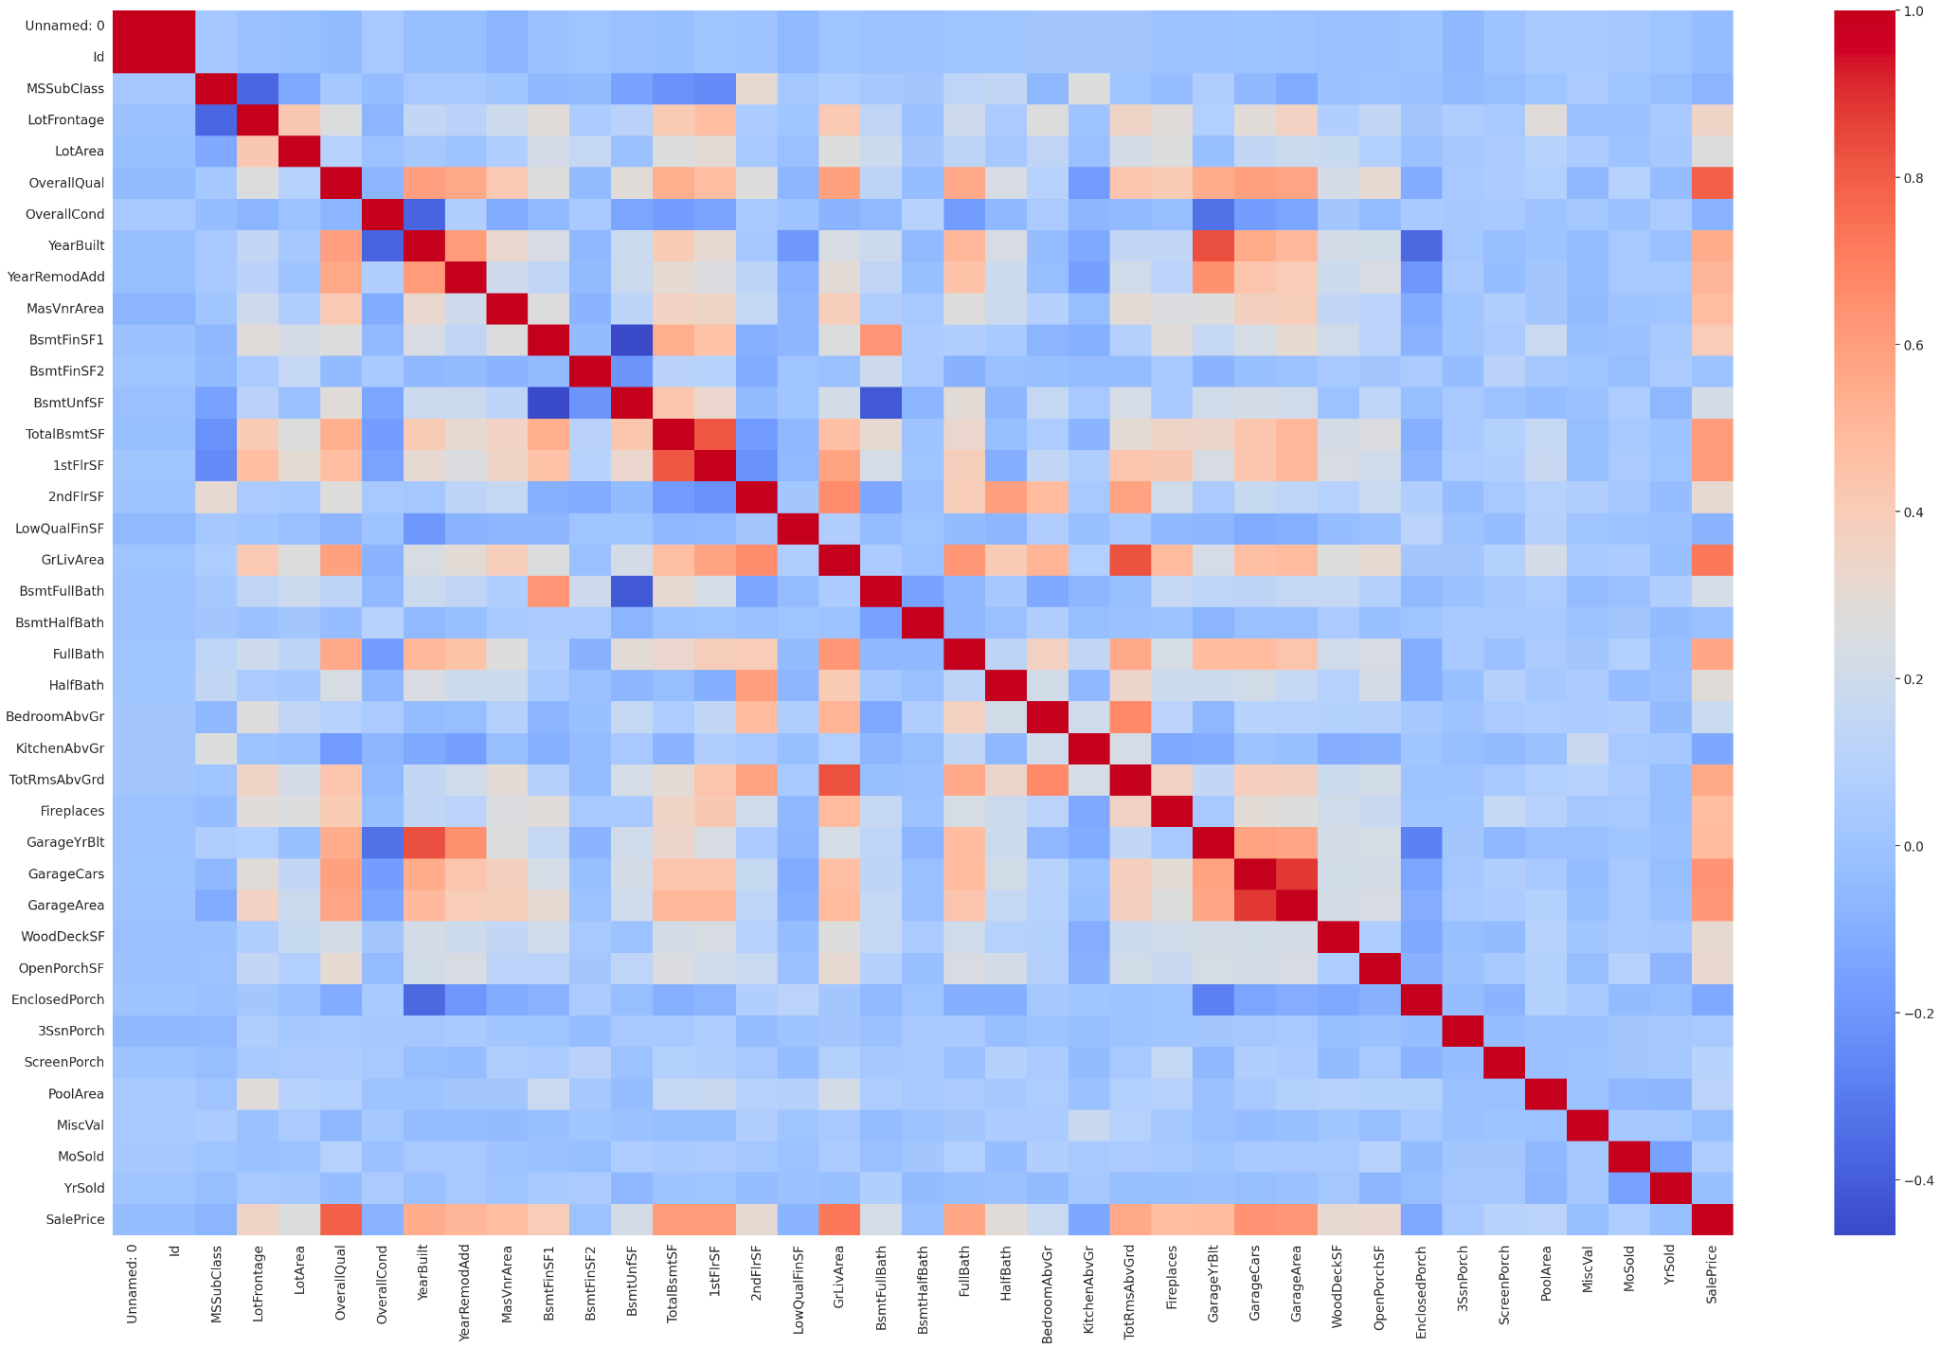
Feature Correlation Analysis and Selection

Slide 5
Data Cleaning and Imputation
Null Value Analysis:
Evaluated dataset for missing values.
Columns Removed:
Removed Columns with > 50% Null Values:
PoolQC, MiscFeature, Alley, Fence, FireplaceQu
Imputation Strategy:
GarageType, GarageFinish, GarageQual, GarageCond - Imputed with 'None' assuming no information available.
LotFrontage - Imputed based on the median value of the neighborhood.
MasVnrArea - Imputed based on the median value of the MasVnrType.

Slide 6
Data Cleaning and Imputation
Rationale for Imputation:
Neighborhood-based Imputation: Utilized neighborhood information for LotFrontage, acknowledging structural symmetry.
MasVnrType-based Imputation: Imputed missing values in MasVnrArea based on MasVnrType grouping.
After Feature Engineering
After Cleaning and Imputation: 75 Columns

Slide 7
Feature Engineering
Introduction of New Features:
Renovated House Indicator: Added a column indicating if the house has been renovated.
House Age Calculation: Introduced 'houseAge' by considering 'YrSold' and 'YearRemodAdd'.
Bathroom and Porch Features:
Total Bathrooms: Introduced 'totBathrooms' by counting the number of bathrooms.
Combined Porch Area: Created 'totPorchSqft' by combining porch areas.
Area-related Feature:
Total Square Feet: Introduced 'totSqrFt' by combining relevant area columns.
Combination of Heating Features:
Combined 'Heating' and 'HeatingQC' into 'heatingQualCond'.

Slide 8
Feature Engineering
Transformation of Categorical Columns:
Numerical Conversion: Transformed 'TotalBsmtSF' into 'HasBsmt'. Transformed 'Fireplaces' into 'HasFirePlace'.
Column Reduction: Dropped skewed columns: 'MiscVal', 'LowQualFinSF', 'PoolArea'.
Total columns reduced to 61.
Categorical Values Replacement:
Replaced values in 'Neighborhood', 'Exterior1st', 'Exterior2nd', 'heatingQualCond'.

Slide 9
Feature Importance Analysis
1. Feature Importance Evaluation:
Utilized models like Random Forest and Linear Regression for feature importance analysis.
2. One-Hot Encoding:
Converted categorical columns into numerical using one-hot encoding.
3. Evaluation on Testing Dataset:
Applied the feature importance analysis on the testing dataset.

Slide 10
Feature Importance Analysis
4. Excel-based Ranking: Utilized Excel to rank features based on importance.
5. Top 35 Features Selection: Combined importance scores for one-hot encoded columns.
Ranked and selected the top 35 features for further analysis.
6. Dataset Reduction:
Reduced the dataset to the most influential 35 features.

Slide 11
Model Evaluation and Hyperparameter Tuning
Models Used: Ensemble Models:
RandomForestRegressor
AdaBoostRegressor
LGBMRegressor
XGBRegressor
GradientBoostingRegressor
Linear Model: LinearRegression,Support Vector Regressor
Initial Model Evaluation:
Split the dataset into training and testing sets (X_final_train, y_train, X_final_test, y_test).
Initial MSE values:
Linear Regression: 960,104,859.24
Random Forest: 870,550,474.50

Slide 12
Model Evaluation and Hyperparameter Tuning
1. AdaBoost: Builds a model by combining multiple weak models. Focuses on correcting mistakes made by individual models
2. Random Forest: Builds an ensemble of decision trees. Each tree is trained on a small sample of the dataset.
3. Support Vector Regressor (SVR): Finds a plane representing the relationship between input and output features.
4. GradientBoosting: Builds a strong model by adding weak models iteratively.
5. LGBM Regressor: Tree-based function. Focuses on improving speed and efficiency, ideal for larger datasets.

Slide 13
Model Evaluation and Hyperparameter Tuning
6. XGBoost Regressor:Known for performance and regularization techniques. Utilizes advanced regularization techniques to prevent overfitting.
7. Conclusion:
Each model has its unique approach and strengths, catering to different aspects of the dataset.
Ensemble methods like AdaBoost, Random Forest, and GradientBoosting leverage multiple models for improved accuracy.
LGBM Regressor and XGBoost Regressor bring efficiency and performance enhancements.

Slide 14
Model Evaluation and Hyperparameter Tuning
Hyperparameter Tuning:
Implemented K-fold cross-validation and GridSearchCV for parameter optimization.
Utilized a custom function, model_evaluate_gridsearch(), within the pen_ultimate_function.
GridSearchCV Function: Splits data into training and validation sets (K=5).
Applies GridSearchCV to find the best hyperparameters.
Returns the best parameter, along with metrics like MSE, RMSE, etc.
Penultimate Function:
Calls model_evaluate_gridsearch() for each model and parameters grid.
Gathers best parameters and evaluation metrics.

Slide 15
Test Predictions Evaluation
Best Parameter Application: Applied the best-tuned hyperparameters on each individual model.
Stacking Model:Utilized StackingRegressor to combine individual models.
RandomForestRegressor
AdaBoostRegressor
LGBMRegressor
XGBRegressor
GradientBoostingRegressor
LinearRegression
SVR
Test Predictions:
Ran the algorithms on the testing dataset with the best-tuned parameters.

Slide 16
Stacking Model
base_models = [
('ada', AdaBoostRegressor(learning_rate= 0.5, loss= "linear", n_estimators= 100)),
('rf', RandomForestRegressor(max_depth= 30, max_features= "sqrt", min_samples_leaf= 1, min_samples_split= 2, n_estimators= 200)),
('svr', SVR(C= 10, gamma= "scale", kernel= "rbf")),
('gb', GradientBoostingRegressor(learning_rate= 0.1, max_depth= 4, min_samples_leaf= 1, min_samples_split= 2, n_estimators= 200)),
('lgbm', LGBMRegressor(colsample_bytree= 0.8, learning_rate= 0.1, max_depth= 4, min_child_samples= 20, n_estimators= 100, num_leaves= 31, subsample= 0.8)),
('xgb', XGBRegressor(colsample_bytree= 0.8, learning_rate= 0.1, max_depth= 4, min_child_weight= 1, n_estimators= 200, subsample= 1.0)),
]

Slide 17
Test Predictions Evaluation
Stacking Performance:
Combined the predictions using StackingRegressor.
Final MSE value on the stacking method: 661,650,286
Results Analysis:
Evaluated the overall performance of individual models and the stacking ensemble.
Conclusion:
Determined the effectiveness of the stacked model in improving predictive accuracy.

Slide 18
Thank You!

